Slide 1

School of Advanced Computing
Computer Science and Engineering - General
1.
TTT
A. Shane Rabbani
Name of the Mentor: Dr. Rajkumar N
5CS1990/5IT1990 Design Project -1
Social Engineering and Human Hacking

Slide 2

Agenda
1. Introduction
2. Review of literature (Refer minimum of 10 Recent Journal / Conference papers)
3. Observations from the literature review (Brief description as points)
4. Limitations from the literature review (Brief description as points)
5. Problem Definition & Proposed Methodology
  a. Problem Statement
  b. Proposed Research / Methodology
  c. Hardware Requirements
  d. Software Requirement
6. References(Min. of 10 pages)
7. Plagiarism Report

Slide 3
Introduction
Definition – Social engineering is the psychological manipulation of people to gain confidential information or perform actions that compromise security.
Human Hacking – A subset of social engineering that targets human emotions, trust, and behavior rather than technology.
Objective – To exploit human weaknesses rather than system vulnerabilities to achieve unauthorized access or data theft.
Core Idea – “Humans are the weakest link” in cybersecurity; attackers exploit trust, fear, curiosity, or greed.
Psychological Manipulation – Uses influence, persuasion, or deception techniques to trick individuals into revealing information.
Common Targets – Employees, administrators, and even the general public, who might unknowingly aid attackers.

Slide 4

Literature Review
S.No | Author Name, Journal, Publication Year | Research / Methodology | Performance Metrics | Advantages | Disadvantages
1 | Hussain & Rahman – Journal of Cybersecurity and Information Systems (2023) | Combined online surveys and phishing simulations inside corporate environments. Observed employee reactions to suspicious emails to measure awareness levels and behavioral change. | Email response rate(38.6 %), awareness improvement score (71.4 %) | Identified psychological triggers behind phishing attacks. | Limited to corporate users; no focus on social media attacks.
2 | Singh et al. – International Journal of Information Security Studies (2022) | Used both interviews with IT professionals and analysis of user behavior to understand recognition of manipulation tactics. | Detection accuracy(91.8 %), response time (2.4 seconds) | Provided insights into how human factors influence cybersecurity risk. | Small sample size limits generalization.
3 | Almeida & Chen – IEEE Transactions on Human-Centered Computing (2021) | Designed controlled experiments replicating phishing, baiting, and pretexting attacks; tracked user reactions and emotions. | Attack success rate(27.5 %) , defense effectiveness(82.3 %) | Demonstrated real-time responses to manipulation attempts. | Controlled environment doesn’t mirror real-world threats.
4 | Kumar & Desai – Journal of Applied Machine Learning and Cybersecurity (2024) | Used machine learning models to analyze phishing datasets and detect early indicators of manipulation. | Precision(94.2 %), recall(92.8 %), F1 score(93.5 %) | Improved accuracy in identifying potential social engineering threats. | Requires large datasets and advanced computation.
5 | Petrovic & Lang – Computers & Security Journal (2020) | Conducted a long-term analysis of social media data using data mining and sentiment analysis to detect manipulation trends. | Engagement rate(42.7 %), attack spread rate(19.4 %). | Revealed how emotional content enhances manipulation success online. | Raises ethical issues over user data privacy.

Slide 5
Observations from the Literature Review
The reviewed studies show that human behavior is a major factor in successful social engineering attacks, as attackers often exploit trust, fear, or curiosity.
Most research emphasizes that employee awareness and training play a key role in preventing phishing and manipulation attempts.
Several studies used controlled simulations and experiments to understand user reactions, but such setups cannot always mirror real-world attack conditions.
The adoption of machine learning and artificial intelligence techniques is helping in the early detection of social engineering patterns with better accuracy.
Researchers found that social media platforms are being widely used by attackers to study, influence, and deceive users emotionally.
Case studies across organizations reveal that well-prepared companies recover faster and manage human-based attacks more efficiently.
Overall, it is observed that technical defenses must be supported by user awareness, continuous training, and behavior-based prevention strategies.

Slide 6
Limitations from the Literature Review
Social engineering exploits human psychology via phishing, pretexting, and baiting.
Studies use surveys, interviews, experiments, and machine learning to analyze behavior.
Research shows which human factors make attacks successful.
Detection methods and awareness strategies have been developed.
Most studies are limited to corporate or controlled environments.
Small datasets and ethical concerns limit generalization.
Real-world social media attacks are underexplored.

Slide 7
Problem Statement / Scope of the Project
Human vulnerability is often the weakest point in cybersecurity, making individuals easy targets for manipulation.
Lack of awareness among employees and users allows attackers to exploit trust and emotions to gain unauthorized access.
Traditional security measures (like firewalls and encryption) focus on technical defenses, ignoring human-based threats.
Increasing sophistication of social engineering techniques makes it difficult to detect and prevent such attacks.
Phishing, vishing, and baiting attacks continue to rise, resulting in significant data breaches and financial losses.
Insufficient training programs lead to poor recognition of deceptive communication or suspicious activities.

Slide 8
Proposed Idea / Solution
Develop a comprehensive framework to understand and analyze various forms of social engineering and human hacking attacks.
Design a simulation or model that demonstrates how attackers exploit human behavior to gain unauthorized access.
Implement awareness-based defense mechanisms that educate users about common manipulation tactics.
Integrate machine learning or behavior analysis tools to detect suspicious communication patterns or phishing attempts.
Create a training and testing module to evaluate employee responses to simulated attacks.
Introduce multi-layered authentication and verification processes to minimize human errors in security systems.

Slide 9
Objectives of the Idea
To explore how social engineering techniques manipulate human emotions and behavior to gain unauthorized access.
To assess the level of awareness and vulnerability among individuals regarding common social engineering attacks.
To identify key psychological and situational factors that increase the likelihood of falling victim to these attacks.
To evaluate the effectiveness of current security training programs in reducing human susceptibility to manipulation.
To develop recommendations for improving security awareness and behavior through targeted education and practical exercises.
To contribute to the creation of strategies that organizations can implement to better protect themselves from human-based cyber threats.

Slide 10
Proposed Research Methodology
Literature review & scope definition — Survey academic papers, industry reports, and case studies to define attack types, target populations, and research gaps.
Threat taxonomy & attack classification — Create a taxonomy (phishing, vishing, smishing, baiting, pretexting, tailgating, etc.) and map variants and techniques under each class.
Ethics, legal & consent framework — Define ethical bounds, obtain IRB/ethics approvals where needed, prepare consent scripts, and build a legal checklist for simulations and data collection.
Data collection plan — Specify sources (simulated interactions, red-team reports, anonymized incident logs, public datasets), collection methods, and storage/privacy controls.
Persona & scenario development — Create representative user personas (roles, tech-savviness, cultural context) and realistic attack scenarios for simulations and tests.
Design of simulation environment — Build a controlled platform to run social-engineering exercises (email/SMS/call simulations, physical access tests) with logging and rollback capabilities.

Slide 11
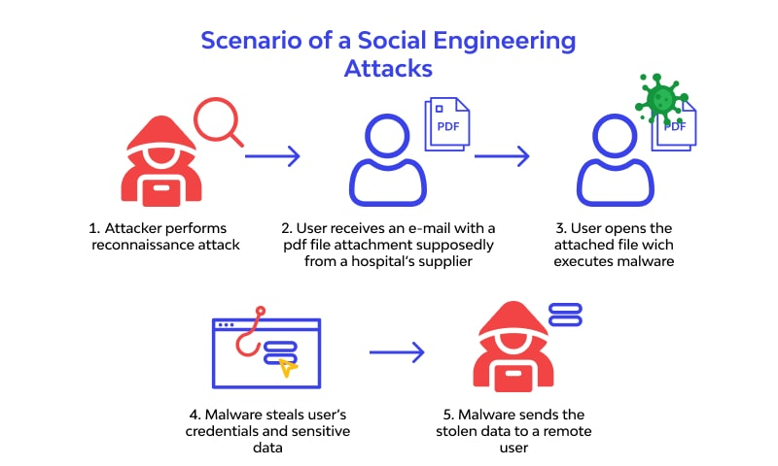
Proposed Methodology

Slide 12
Hardware Requirements
Project/VM host (lab server) — 12–16 CPU cores, 128 GB RAM, multiple NVMe (2–4 TB) for fast VMs and snapshots; hardware RAID or equivalent for redundancy.
Analysis / ML server (optional) — Multi-core CPU, 64–256 GB RAM, at least one GPU with ≥16 GB VRAM (for NLP/behavior models), 4–8 TB SSD.
Database / logging server — 8+ cores, 64 GB RAM, 8+ TB HDD or NAS (RAID) for long-term logs, with fast SSDs for DB indices.
Phishing/simulation web server (isolated VLAN) — 4–8 cores, 32–64 GB RAM, 1–2 TB SSD; runs mail/web simulation tools in sandbox.
Mail/SMTP sandbox — Dedicated VM or appliance for sending simulated emails (isolated, rate-limited, legal/consent controls).
Endpoint test machines (diverse fleet) — 6–12 workstations/laptops covering Windows (7/10/11), macOS, and common Linux distros; each with 8–16 GB RAM, 256–512 GB SSD.
Mobile device pool — 4–8 smartphones/tablets (mixed Android/iOS; different OS versions) for smishing and app-based scenarios.

Slide 13
Software Requirements
Host OS / Server OS — Linux (Ubuntu Server/CentOS/RHEL) for lab servers; Windows Server (2019/2022) if testing AD/Windows-specific scenarios.
Desktop OS images — Windows 10/11, macOS recent, and common Linux distros (Ubuntu, Fedora) as VM templates for endpoint testing.
Hypervisor / Virtualization — VMware ESXi / Proxmox / Hyper-V or VirtualBox for local VMs; support for snapshots and isolated VLANs.
Container platform — Docker + Docker Compose for lightweight services; Kubernetes (k3s/minikube or full K8s) for scalable deployments.
Email / SMTP server (sandboxed) — Postfix / Exim / Haraka or a managed sandboxed mail server; integrates with testing tools and rate-limiting.
Phishing / simulation platform — GoPhish (or similar) for templated phishing campaigns, link tracking, and campaign reporting.
Web server / app stack — Nginx or Apache, plus frameworks (Node.js/Express, Django/Flask, or ASP.NET) for simulated landing pages and credential capture (ethical use only).

Slide 14
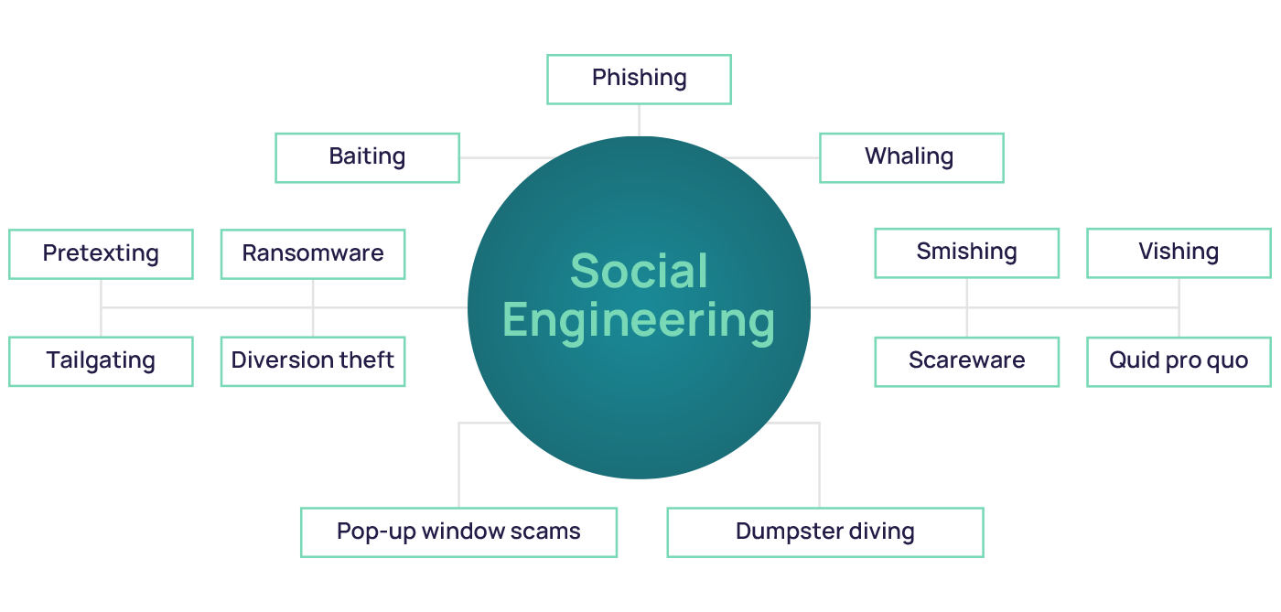
Flow Diagram

Slide 15
Phishing – Attackers send fake emails or messages that look genuine to trick people into revealing passwords, banking details, or other private data. It’s one of the most common online scams.
Whaling – This targets senior executives or high-profile individuals through customized messages that seem official, aiming to steal sensitive company or financial information.
Smishing – A mix of SMS and phishing, where fraudsters send text messages pretending to be banks or services, urging victims to click links or share account details.
Vishing – Criminals use phone calls to impersonate trusted people like bank officers or IT staff, convincing victims to share confidential information or install harmful software.
Quid Pro Quo – Scammers promise help, like technical support or a free service, but use it to get login details or system access. It relies on the victim’s willingness to exchange information.
Scareware – Fake alerts warn users that their computer is infected, prompting them to download “security tools” that are actually malware. Fear is the key manipulation factor here.
Dumpster Diving – Hackers go through discarded papers, drives, or devices to find passwords, confidential reports, or personal data that can be misused.
Pop-Up Window Scams – Fake pop-up ads appear while browsing, asking users to click or download “updates,” which secretly install spyware or steal information.
Pretexting – The attacker creates a believable scenario (like a survey or verification call) to gather personal or organizational details without raising suspicion.
Tailgating – Unauthorized individuals follow legitimate employees into secure buildings or areas without an access card, often pretending to have forgotten theirs.
Baiting – Attackers leave infected USB drives or free downloads in public places, hoping someone plugs them in or installs the software, leading to system breaches.
Ransomware – Malicious software encrypts files or locks systems, demanding money to unlock them. It often spreads through email attachments or unsafe links.
Diversion Theft – Fraudsters intercept or redirect deliveries, shipments, or online data transfers, pretending to be legitimate recipients to steal valuable goods or information.

Slide 16
Proposed Modules
1. Understanding Attacker Mindset
How attackers plan, choose targets, and build trust before launching attacks.
Identifying emotional triggers attackers commonly exploit (fear, urgency, trust).
Learning how attackers adapt strategies when faced with resistance.
2. Social Engineering Attack Lifecycle
Step-by-step stages: Reconnaissance → Engagement → Exploitation → Exit.
Recognizing early warning signs at each stage.
Importance of documentation and evidence collection during investigations.
3. Insider Threat and Internal Manipulation
Employees, contractors, or partners may misuse authorized access.
Psychological and financial pressures that lead to insider compromise.
Monitoring behavioral red flags and reporting procedures.
4. Business Email Compromise (BEC) Fraud
Impersonating executives or employees to request payments or sensitive data.
Email spoofing indicators and verification methods.
Case-based learning on financial loss prevention.

Slide 17
Novelty of the proposed Idea / Project
Behavioral micro-signatures: Introduces short, trackable micro-behaviors (micro-signatures) — e.g., response latency patterns, phrasing switches — that reliably indicate social-engineering susceptibility beyond simple click rates.
Adaptive pretext generation: Uses an automated, ethical pretext-generation framework that combines OSINT-derived context with randomized safe variants to create high-variability, low-repetition social tests.
Emotion-aware training modules: Training that adjusts content and timing based on detected emotional states (survey/interaction cues), improving retention vs. one-size-fits-all drills.
Cross-channel correlation detection: Correlates phishing, vishing, and social-media signals to detect coordinated multi-channel campaigns earlier.
Human-in-the-loop automated red-teaming: A hybrid system where automation proposes attack vectors and human testers verify/steer them—faster while retaining ethical judgment.
Context-preserving OSINT sanitization: New methods to create realistic but anonymized target profiles for labs (retain realism while preventing doxxing).
Privacy-first measurement metrics: Novel KPIs that measure awareness without exposing individuals (e.g., aggregated “verification attempts per 1,000 requests”).

Slide 18
Conclusion
Humans are the primary vulnerability — Social engineering exploits psychological and emotional factors rather than technical flaws.
Attacker mindset is strategic — Understanding how attackers plan, select targets, and manipulate trust is essential for prevention.
Lifecycle awareness is crucial — Recognizing the stages of social engineering attacks (reconnaissance, engagement, exploitation, exit) helps detect threats early.
Insider threats pose significant risk — Employees, contractors, or partners can misuse access due to financial, psychological, or ideological motivations.
BEC and email-based attacks are highly effective — Impersonation and urgent requests can lead to financial loss without proper verification protocols.
Prevention requires a layered approach — Combining technical defenses, behavioral awareness, and organizational policies reduces vulnerability.
Continuous training is key — Employee education, simulations, and awareness programs strengthen resilience against evolving tactics.

Slide 19
References
Montañez, R., Golob, E., & Xu, S. (2020). Human cognition through the lens of social engineering cyberattacks. Frontiers in Psychology, 11. https://doi.org/10.3389/fpsyg.2020.01755 Frontiers
Bhusal, C. S. (2021). Systematic review on social engineering: hacking by manipulating humans. Journal of Information Security, 12, 104‑114. SCIRP
Joseph, R. (2023). The human factor: Exploiting psychology in cyber‑attacks through social engineering. International Journal of Machine Learning Research in Cybersecurity and Artificial Intelligence, 14(1), 954‑966. ijmlrcai.com
Nonum, E. O., Avwokuruay e, O., & Umar, A. M. (2025). Social engineering: Understanding human factors in cybersecurity. International Journal of Convergent and Informatics Science Research. harvardpublications.com
Singh, S., Abri, F., & Siami Namin, A. (2023). Exploiting large language models (LLMs) through deception techniques and persuasion principles. arXiv. arXiv
Schmitt, M., & Flechais, I. (2023). Digital deception: Generative artificial intelligence in social engineering and phishing. arXiv.

Slide 20
Thank You

